Slide 1
CISC 1600/1610 Computer Science I
Programming in C++
Professor Julie Harazduk
jharazduk@fordham.edu
Office: JMH 338

Slide 2
Each class – Take Attendance on BB
Click the Class
Click Tools
Click Qwikly Attendance
Enter the 4 digit number

Slide 3
This is a course…
In Programming
For beginners
who want to become professionals
i.e., people who produce systems that others will use
who are assumed to be bright
Though not (necessarily) geniuses
who are willing to work hard
Though do need sleep occasionally, and take a normal course load
Using the C++ programming language

Slide 4
Instructor
Prof. Julie Harazduk
Email: jharazduk@fordham.edu
Office hours: Tue 11:30-12:45, Thu 1:00-2:15, and Wed 11 or 2:15 by appt
Using Zoom: https://fordham.zoom.us/j/2382029517
Office: JMH 338
Website:https://storm.cis.fordham.edu/harazduk/cs1600

Slide 5
Introduction to programming with C++
Learn
Fundamental programming concepts
Key techniques
Basic C++ facilities
By the end of the course, you will be able to:
Write small, modular C++ programs
Read much larger programs
Proceed to advanced C++ courses

Slide 6
Requirements
Attendance and participation
Lectures and lab sessions
Lab assignments – roughly 12 weekly
Quizzes – each 15 minutes, 2 per semester
Exams – 1 midterm, 1 final (each 2 parts)
Academic integrity – may discuss assignments with your classmates, but you MUST write all your code and all your answers yourself

Slide 7
How to succeed in class
Ask questions
In class
In office hours JMH 338, tutor room JMH 310
Study together and discuss assignments with each other (without plagiarizing!)
Read Textbook
Read and re-read the material, self-test!
Complete practice problems for credit!
Start coding and studying early – PLAY Around!
Notes:
I read a book this summer about how people learn. Self-testing is the best method, mix it up instead of all of the same tests.

Slide 8
Course textbook
We will be using an interactive book, called a zyBook.
This is how you get it:
1. Sign in or create an account at learn.zybooks.com
With your @fordham.edu email address
2. Enter zyBook code: FORDHAMCISC1600-R02Fall2021
3. Hit Subscribe

Slide 9
Course Material
Blackboard and Website
http://storm.cis.fordham.edu/harazduk/cs1600
Go online for
Announcements
Lecture slides
Course materials/handouts
Assignments

Slide 10
“Two courses in one”: CISC 1600 and CISC 1610
CISC 1600 and 1610 cover lecture and lab
We may work in lab during lecture time
We may have lecture during lab time
Listen for announcements during class/online!
Read your email at least twice a day!

Slide 11
A program provides a computer with a set of simple instructions to achieve a goal
Notes:
My son’s first HW in his Comuter Science Principles. Write an algorithm to put on a jacket.

Slide 12
Think about a program to put on a jacket?
What does it need to do?
How exact does it need to be?
We’ll come back to it.

Slide 13
Programs are everywhere
On your computer:
Web browser
Request and display information from distant sites
Word processor
Record text, change appearance, save to disk
Anywhere else?

Slide 14
Programs are everywhere
In the dining hall:
Cashier
Compute price of food purchase, charge payment to account, (if pay cash: compute change)
HVAC
Monitor temperature, adjust A/C or heating
And beyond…
Self-Driving Car!

Slide 15
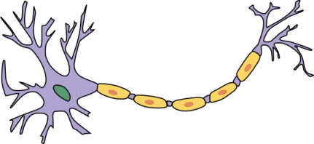
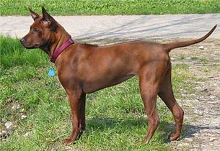
Programs are everywhere
In humans:
Sports
When to run, where to run; when to pass, who to pass to; when to shoot
The brain
Neurons working together to combine information about an image to recognize a dog or a car
Head
detector
dog
Tail
detector

Slide 16
Programs have to be precise
Programs are written in a programming language.
Programs must use correct grammar (syntax).
Programs must have correct logic (semantics).
Programs run on a computer.
Most computers are dumb.
They do exactly what you say to do, not what you meant for them to do.
They can’t fill in missing details. If you leave out a detail, it won’t get done.

Slide 17
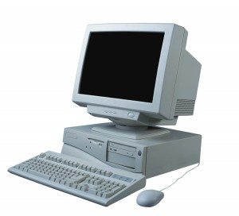
Computer system structure
Central processing unit (CPU) – performs all the instructions
Memory – stores data and instructions for CPU
Input – collects information from the world
Output – provides information to the world
Output
CPU
Memory
Input

Slide 18
Tiny Bit of C++ History
Built as an extension of ‘C’
C (Kernigan & Ritchie – Bell Labs 1969-1972)
By Bjarne Stroustrup at Bell Labs
(Danish Masters in Math & CS)
Began in 1979. First published in 1985

Slide 19
Why C++?
Popular modern programming language
In use since 1980’s
Similar structure to many/most other popular languages (Java, C#, Javascript)
Exposes low level concepts in a high level language.
Take CISC2000/2010 to see the low level and high level constructs.

Slide 20
Ready program to put on a jacket?
What does it need to do?
How exact does it need to be?
How would you start?

Slide 21
Pseudocode to put on a jacket
Pick up jacket with two hands
Repeat the following until the jacket is upright
Turn jacket in x,y dimension 90 degrees
Are sleeve openings facing you?
Turn jacket in x,z dimension 180 degrees
Pick one hand to hold jacket
Place other hand into opposing sleeve and push arm thru…

Slide 22
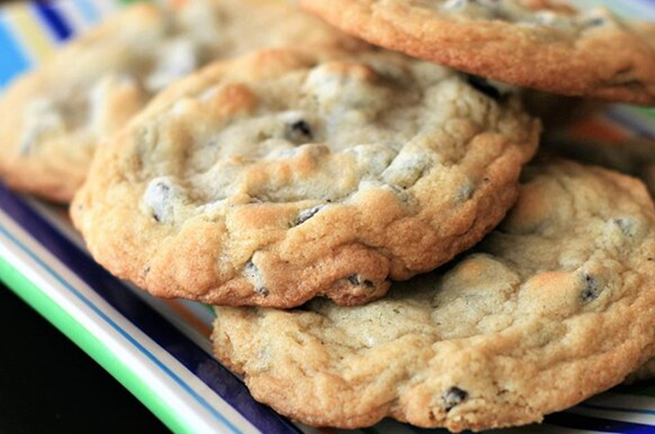
Programming Process
Start with a goal
Chocolate chip cookies! Mmmm…
Break it down into steps

Slide 23
Chocolate Chip Cookies
Ingredients
(makes 4 dozen)
1 cup butter, softened
1 cup white sugar
1 cup packed brown sugar
2 eggs
2 teaspoons vanilla extract
1 teaspoon baking soda
2 teaspoons hot water
½ teaspoon salt
3 cups all-purpose flour
2 cups semisweet chocolate chips
1 cup chopped walnuts
What are the 4 general steps?
Step 1:
Step 2:
Step 3:
Step 4:

Slide 24
4 Dozen Chocolate Chip Cookies
Ingredients
(makes 4 dozen)
1 cup butter, softened
1 cup white sugar
1 cup packed brown sugar
2 eggs
2 teaspoons vanilla extract
1 teaspoon baking soda
2 teaspoons hot water
½ teaspoon salt
3 cups all-purpose flour
2 cups semisweet chocolate chips
1 cup chopped walnuts
Step 1: Preheat oven to 350 degrees F
Step 2: Mix Everything
Step 3: Drop large spoonfuls onto pans
Step 4: Bake

Slide 25
How do we 'talk to a computer'?
Programming 'Languages'
Like spoken languages:
you must practice
there are several ways to say the same thing
Unlike spoken languages:
The 'answers' are deterministic (predictable)
The grammar is super picky, such as…
Where you put punctuation, capitalization

Slide 26
C++ – high-level language
High-level language
Uses words to describe instructions
More intuitive to people
Computer-independent
Machine-language
Uses binary to describe instructions
Less intuitive to people
Computer-dependent
C++ code
balance=balance-charge;
Compiler
assembly code
10000000 10000100 00110010 01110100
machine code

Slide 27
Compiler
C++ code
Converts your code
to Machine code
balance=balance-charge;
(Sometimes first to Assembly or byte-code, sometimes directly to machine code)
Assembly code
Machine code
0000 0010 0010 1011 1000 1000 0010 0010

Slide 28
Binary
Machine code (binary) is made only of 0s and 1s?
Why?
1 Binary Digit is a Bit 8 Binary Digits is a Byte
0000 0010 0010 1011 1000 1000 0010 0010

Slide 29
A Little Bit about Binary
How high can you count on one hand?
Technique:
Finger up is 1
Finger down is 0
Add the values showing
4
2
8
16
1
Answer: Binary 11111 = 31
Now… count up from 0!
This Photo by Unknown Author is licensed under CC BY-SA
Notes:
Pick up here!

Slide 30
#1. Convert this binary value to decimal
Place value | 16 | 8 | 4 | 2 | 1
 | 0 | 0 | 1 | 1 | 0₂

Slide 31
#1. Convert this binary value to decimal
Place value | 16 | 8 | 4 | 2 | 1
 | 0 | 0 | 1 | 1 | 0₂
= 6₁₀

Slide 32
#2. Convert this binary value to decimal
Place value | 16 | 8 | 4 | 2 | 1
 | 1 | 1 | 0 | 1 | 0₂

Slide 33
#2. Convert this binary value to decimal
Place value | 16 | 8 | 4 | 2 | 1
 | 1 | 1 | 0 | 1 | 0₂
= 26₁₀

Slide 34
Convert Decimal (base 10) to Binary (base 2)
 | 16 | 8 | 4 | 2 | 1
22 | ? | ? | ? | ? | ?
Sum: | + | + | + | + | +
Similar to making change –
How do you hand someone 68 cents? Anyone?
Answer: Pick from high value coins to low
2 Quarters, (subtract 50, leaving 18 cents)
1 dime, leaving 8 cents
1 nickel, leaving 3 cents,
then 3 pennies.

Slide 35
Give the Binary Value for: 5₁₀
 | 16 | 8 | 4 | 2 | 1
Sum: | + | + | + | + | +
 | 0 | 0 | 1 | 0 | 1
Sum: | +0 | +0 | +4 | +0 | +1

Slide 36
Give the Binary Value for: 12₁₀
 | 16 | 8 | 4 | 2 | 1
Sum: | + | + | + | + | +
 | 0 | 1 | 1 | 0 | 0
Sum: | +0 | +8 | +4 | +0 | +0

Slide 37
Give the Binary Value for: 26₁₀
 | 16 | 8 | 4 | 2 | 1
Sum: | + | + | + | + | +
 | 1 | 1 | 0 | 1 | 0
Sum: | +16 | +8 | +0 | +2 | +0

Slide 38
Convert Decimal (base 10) to Binary (base 2)
 | 16 | 8 | 4 | 2 | 1
22 | 1 | 0 | 1 | 1 | 0
Generate 22₁₀ in binary
16? Yes. (1).
22-16 = 6.
8? No. (0).
4? Yes. (1)
6-4 = 2.
2? Yes. (1)
2-2 = 0.
1? No. (0)

Slide 39
Why C++?
Some programming history:
C++ developed as improvement on C
C developed as improvement on B
B developed as improvement on …
BCPL – Basic Computer Programming Language
Various languages before BCPL – ADA, COBOL, FORTRAN

Slide 40
Course outline
Programming basics, input/output, arithmetic
Conditional statements
Loops
Modularity – functions
Complex data – arrays, strings, and classes
Throughout the semester:
Proper programming style

Slide 41
From ThinkGeek.com

Slide 42
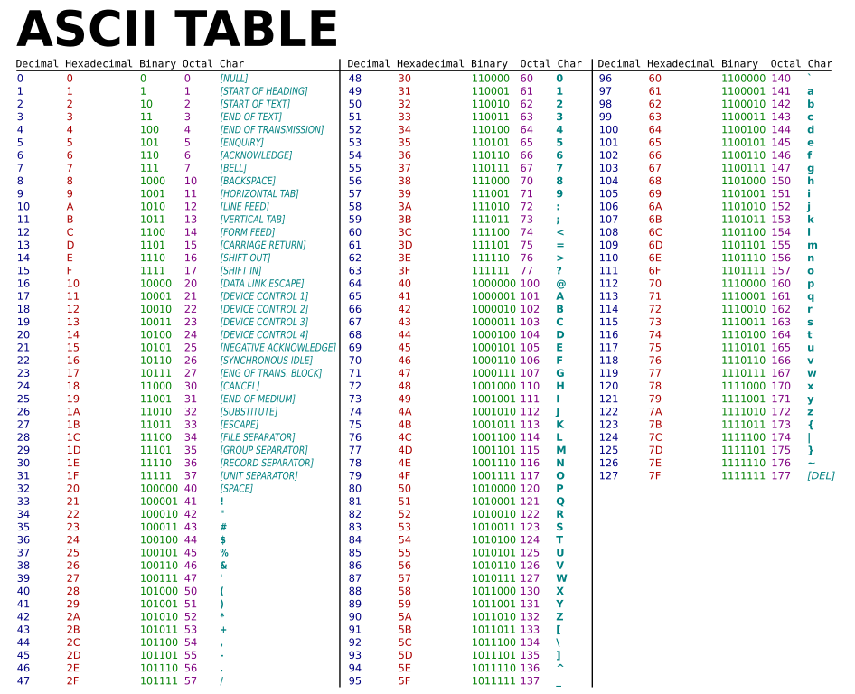
Each character is stored in 1 byte (ASCII binary)
American Standard Code for Information Interchange

Slide 43
Programming basics
Input Information
Perform Calculations
Output Information
Let's start here

Slide 44
What is the name of every first program?
Every course in every programming language starts here!

Slide 45
Our first program: “Hello world!”
Create filename hello.cpp to include:
// include library of standard input and output commands
#include <iostream>
using namespace std;
int main()
{ // Begin main function
cout << "Hello world!\n"; // output "Hello world!“
return 0; /* indicate successful
program completion */
} // End main function
Standard
> g++ hello.cpp
> ./a.out
Hello world!
>

Slide 46
The components of “Hello world!”
Comments //, /* */
main function
Preprocessor directives #include
Literally includes the contents of the file named between <> during the compilation process
[Compilation goes thru 4 steps: preprocess, compile, assemble, link].

Slide 47
Using comments
// include library of standard input and output commands
#include <iostream>
using namespace std;
int main()
{ // Begin main function
cout << "Hello world!\n"; // output "Hello world!"
return 0; /* indicate successful
program completion */
} // End main function
Explain programs to other programmers
Ignored by compiler
Syntax:
// single line comment
/* multi-line
comment */

Slide 48
Preprocessor directives
// include library of standard input and output commands
#include <iostream>
using namespace std;
int main()
{ // Begin main function
cout << "Hello world!\n"; // output "Hello world!"
return 0; /* indicate successful
program completion */
} // End main function
Lines beginning with #
Executed before compiling the program

Slide 49
main function
// include library of standard input and output commands
#include <iostream>
using namespace std;
int main()
{ // Begin main function
cout << "Hello world!\n"; // output "Hello world!"
return 0; /* indicate successful
program completion */
} // End main function
Every C++ program has the function int main()
main contains the instructions to be executed by the program
The instructions included in the “body” of main are placed between curly braces { }

Slide 50
Statements
// include library of standard input and output commands
#include <iostream>
using namespace std;
int main()
{ // Begin main function
cout << "Hello world!\n"; // output "Hello world!"
return 0; /* indicate successful
program completion */
} // End main function
Note that the body of main is indented.
Always indent between brackets!
Instructions to be performed when the program is run
Each statement is completed with a ;

Slide 51
Organize Using “white spaces”
// include library of standard input and output commands
#include <iostream>
using namespace std;
int main()
{ // Begin main function
cout << "Hello world!\n"; // output "Hello world!"
return 0; /* indicate successful
program completion */
} // End main function
“White spaces” are blank lines, space characters, and tabs
White spaces are ignored by the compiler
Use indentation to group pieces of code together

Slide 52
Directory structure Writing and compiling programs with Linux

Slide 53
Linux/UNIX programming environment
Text commands
Directory structure

Slide 54
Command-line interface
Run programs through text commands, rather than through mouse clicks
The “terminal” runs a command-line interpreter
Interpreter waits for a command
User enters text command
Interpreter determines activity to perform based on command
Output of activity displayed in terminal
Go back to waiting (step 1)

Slide 55
Let's Do It!
Lab 0 – setup
Lab 1 – Hello.cpp
See next slide for Mimir

Slide 56
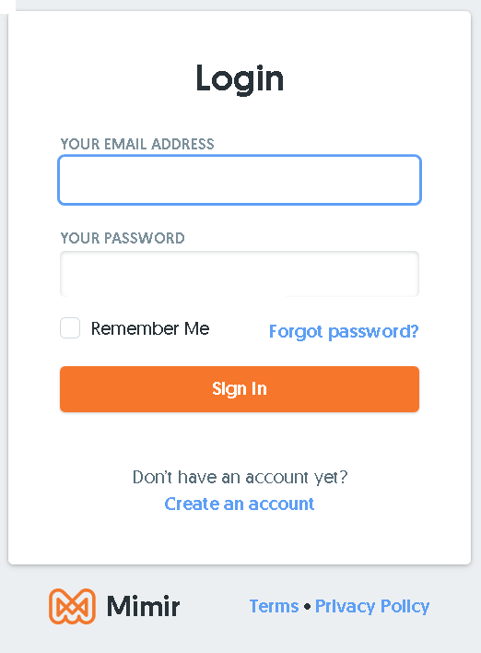
ToDo: Mimir
In a web browser, e.g. Chrome, preferably on your own computer, but can also use another system:
Goto: class.mimir.io
Create account
USE YOUR FORDHAM email

Slide 57
ToDo: Mimir
Join the class with the code I will provide
<Class Code> will be given during class and sent in email.

Slide 58
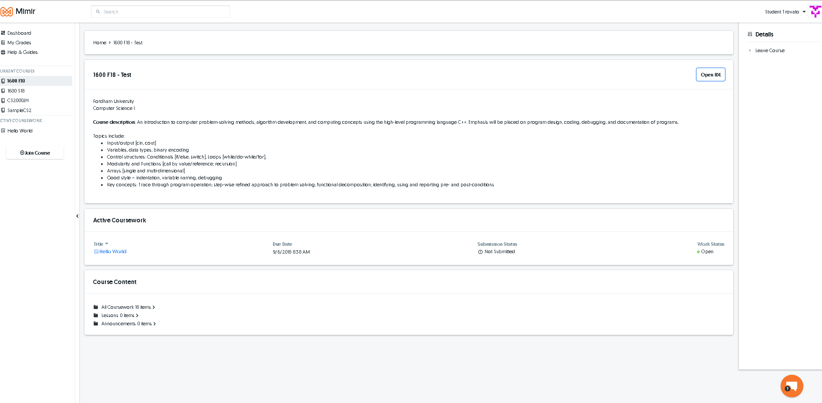
Parts of the Mimir Environment

Slide 59
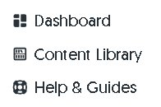
Parts of the Mimir Environment
Later on: Click on a project.
However for our first project we will use the IDE directly
For help

Slide 60
Wait!
Before you start exploring the folders on the left hand side, delete the unnamed window.
Ignore the folders on the left for now!

Slide 61
Using the 'bash' terminal
It will say term on the top left of the window
X
Close this window.
http://help.mimir.io/mimiride/how-to-s/how-to-use-the-terminal-in-the-mimir-ide-to-run-code

Slide 62
Directory structure
Files are stored in directories in your computer. We will store our C++ code and executable files on the computer storm.cis.fordham.edu
(Or in Mimir)
Directories can contain other directories within them
/
home
students
amy
chuck
zoe
cs1
lab1
lab2
lab3

Slide 63
Directory structure
/
zoe is a subdirectory of students
The “full path” of lab1 is:
/home/students/amy/cs1/lab1
home
students
amy
chuck
zoe
cs1
lab1
lab2
lab3

Slide 64
Key commands
Logging into storm (if not using Mimir)
ssh username@storm.cis.fordham.edu
Show name of current directory (“print working directory”)
pwd
List contents of current directory
ls
Make new directory
mkdir newDirectoryName
Change directory
cd DirectoryName

Slide 65
Key commands
Logging into storm (if not using Mimir)
ssh username@storm.cis.fordham.edu
Opening a new file to write
vi myProgram.cpp
Compiling a program
g++ myProgram.cpp
Running a program
./a.out
There are many other Linux commands. I highly recommend you use my list of commands online

Slide 66
ToDo: Make Directories
ls // list files in this directory
pwd // print the name of this (working) dir
ls
mkdir lab1
cd lab1

Slide 67
Additional Commands
!! Repeat last command
cd .. Move up one directory level
. Shorthand for current directory
cat <filename> Print filename to the screen**
Example:
cat hello.cpp

Slide 68
Editing in vi
vi is a very simple text editor that runs in two modes
Command Mode
Edit Mode
In edit mode: type in all the text you want in your file
In command mode: save your file and exit

Slide 69
Editing in vi
Type “i”
Command mode
Edit
mode
:w Save file
:q Exit vi (no save)
:wq write & then quit
Press Esc button
There are many other vi commands. Look at the other vi references in the Tools folder

Slide 70
Vim is similar to vi
Arrow keys also work
Helpful:
Note whether it says ‘--Input—’ at the bottom of the screen

Slide 71
ToDo: Create file called hello.cpp
vi hello.cpp capitalization matters!
Toggle between 'insert mode' and 'command mode'
i insert characters
escape (stop inserting, enter command mode)
:w write (save) file
:q quit (no save)

Slide 72
First Program “Hello world!”
// include library of standard input and output commands
#include <iostream>
using namespace std;
int main()
{ // Begin main function
cout << "Hello world!\n"; // output "Hello world!"
return 0; /* indicate successful
program completion */
} // End main function

Slide 73
More details in creating executable files
g++ myProgram.cpp –o myProgram.out
myProgram.cpp
#include imports instructions from other libraries
Compiler
myProgram object file
iostream library file
Linker
myProgram.out

Slide 74
Let's compile!
g++ hello.cpp
By default, the system creates an executable called a.out in the current directory (.)

Slide 75
Let's run it!
To run it type:
./a.out

Slide 76
Let's submit it! (Mimir)
Click:
The system will ask which currently open project
And then ask you which code you want submitted.

Slide 77
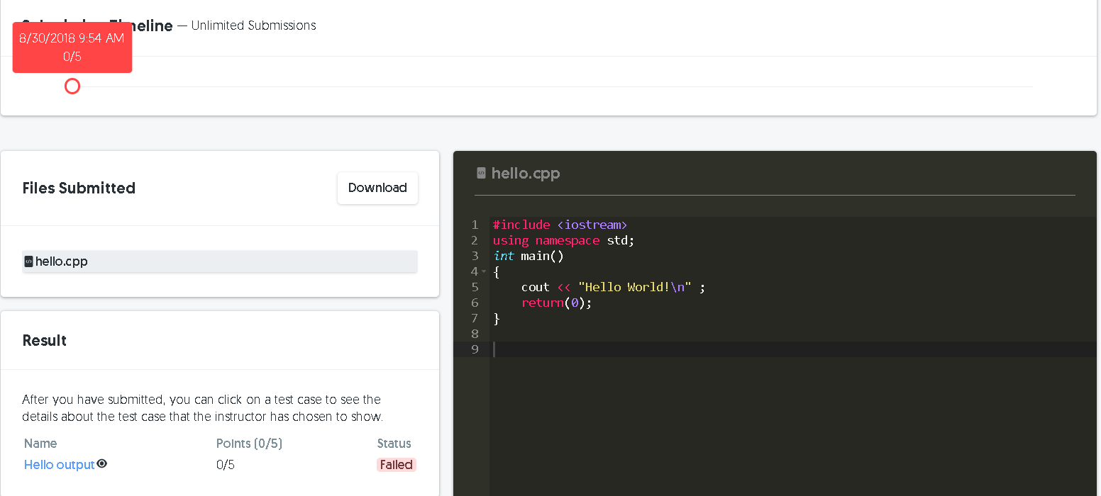
Your results
List of submissions
Recent code
Pass/Fail.
If Failed, click on the test name
(Hello output)

Slide 78
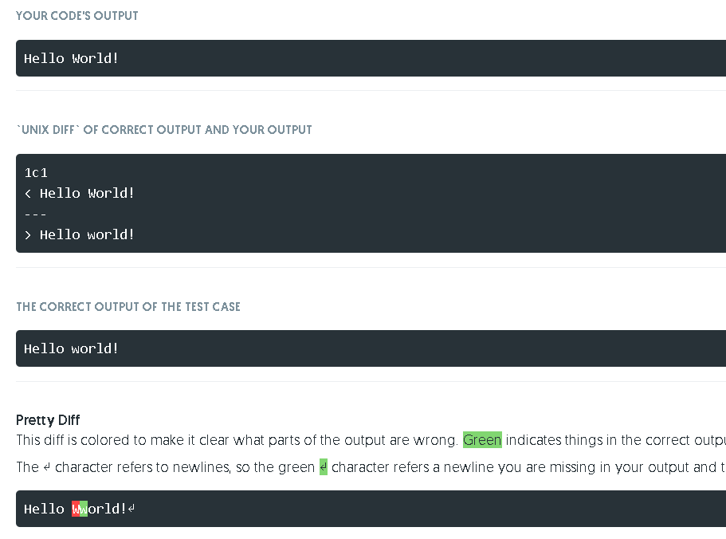
Can you see what is wrong?

Slide 79
Go back and fix!
Quickest way is click on the course
And

Slide 80
After fixing the error
Yay!
You can also see your grades by clicking

